Slide 1
BioSnowball: Automated Population of Wikis (KDD ‘10)
Advisor: Dr. Koh, Jia-Ling
Speaker: Lin, Yi-Jhen
Date: 2010/11/30

Slide 2
Outline
Introduction
Problem Formulation
Overview of BioSnowball
Joint Summarization Model
Experiments
Conclusions

Slide 3
Introduction
Internet users have the need to find summarized information about different aspects of a person of interest.
However,
Current search engines can only return a list of web pages.
Wikipedia only indexes celebrities or notable entities based on the NPOV editorial policy.
Goal:
Summarize the Web to generate Wikipedia-style pages for any person with a modest web presence.

Slide 4
biography blocks
Key facts

Slide 5
Problem Formulation
Only a small region of web page contains descriptive information:
Segment web pages into blocks
Built a name-to-block inverted index
We generate key facts and biography blocks as summaries for each person:
A fact can be represented as (e, np, key)
e: entity
np: noun phrase
key: keyword that indicates the fact type
(Bill Gates, CEO of Microsoft, occupation)
A biography can be represent as {b₁, b₂, …, b_{k} }
b_{i} : biography block (bio-block)
b_{i} $∈$ B_{e}
B_{e} : contextual blocks of entity e

Slide 6
Problem Formulation
Task:
Given a specific person e and his/her contextual blocks B_{e}
Jointly find
the top-k non-redundant bio-blocks within B_{e}
non-redundant facts extracted from B_{e}

Slide 7
Overview of BioSnowball
P1: Input
Seeds can be collected from Wikipedia pages
P2: Bootstrapping Summarization Model
For each training block, extract facts and classify whether it is a bio-block
Bio-blocks and corresponding facts are then added into the data base for next round training
After getting more training blocks, BioSnowball generates patterns from the training data
P3: Post-processing
Apply clustering on the output from P2 (facts and blocks) to disambiguate several people with the same name
Re-rank these bio-blocks using MMR algorithm to make the summary more diverse

Slide 8
Maximal Marginal Relevance

Slide 9
Joint Summarization Model
The joint summarization model jointly perform the two tasks of people summarization
Fact extraction and biography ranking
Bio-Fact duality
A biography is composed of key facts and can be ranked by the facts it contains
Facts about the entity can be more easily extracted from the biography than non-biographies
We adopt Markov Logic Networks (MLNs) as the underlying extraction model to capture such dependency

Slide 10
Markov Logic Networks
Given Formulae:
Predicate: Sm(x) Fr(x,y)
Grounding: Sm(A) Fr(A,B)
Two constants: Anna (A) and Bob (B)
Friends(A,B)
Friends(A,A)
Smokes(A)
Smokes(B)
Friends(B,B)
Cancer(A)
Cancer(B)
Friends(B,A)

Slide 11
Markov Logic Networks
Evidence predicates X
All possible features generated from the input
Query predicates Q
The fact queries Fact and bio-block queries BioBlock
Given a input x$∈$X, MLN defines
g_{j}j(q, x) equals to 1 if the jth ground formula is true and 0 otherwise
Gi : the set of ground formulae of the ith first-order formula
F_{Q} : the set of formulae with at least one grounding involving a query atom
Z(w, x) is a normalization factor

Slide 12
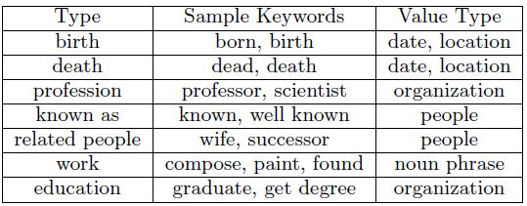
Fact Extraction
7 fact types
Query predicate
Fact (e_{i} , np_{j} , b_{k} , r_{l}) , ex: (Bill Gates, CEO of Microsoft, b_{k} , occupation)
b_{k} : block containing e_{i} and np_{j}
General patterns
POS tag sequence appearing between entity and noun phrase
Keyword-matching patterns
VB: (e₁, marry, e₂)
IN: (e₁, CEO of, e₂)
POS: (e₁, ‘s career, e₂)

Slide 13
Biography Ranking
Biography patterns
A biography tends to have relatively fixed writing style and specific vocabulary, ex: “is born”, “graduated from”
For every name in the block, a window of size w is used to get left and right context words around the entity, and generate biography patterns
BioPattern : all possible biography patterns
BioBlock : Another query predicate which means b is a bio-block with entity e

Slide 14
Joint Summarization
Fact extraction and biography ranking can help each other. Consider three cases:
As Bio-Fact duality indicate, biography can be ranked by facts it contains
If we have inferred a block is a bio-block, the co-reference problem becomes easier because most of the pronouns are the entity
If a fact f of type r is found in a bio-block, some fact types are more likely to appear after or before that

Slide 15
Training and Inference
The weight learning is a mixture of the supervised and unsupervised learning, which both target at maximizing the conditional log-likelihood
Supervised
Unsupervised
Sum the probability over the unknown query predicate B, and maximize the conditional log-likelihood

Slide 16
Experiments
Two Data sets
Initial seed (WikiSeed)
Obtained from Wikipedia
17850 people with both the infoboxes and bio-blocks
Web blocks (Web1M)
1 million blocks
Used as the training blocks during the bootstrapping process

Slide 17
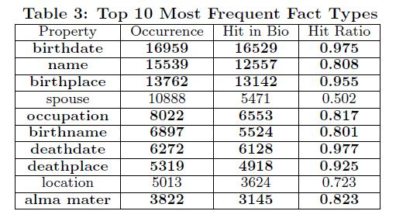
Experiments
Bio-Fact Duality
Use Wikipedia data, locate facts in the corresponding bio-blocks
64.6% facts are founded in the biography blocks
The first bio-block contains 5.98 facts per person on average (average sentence count of the first bio-block is 2.34)
The second bio-block: 2.74 facts, the 3rd to 8th: about 1 fact
84.2% occur in
the bio-blocks

Slide 18
Experiments
Important facts occur in the biography blocks.
The bio-blocks contain many facts.
The more important bio-blocks contain more facts (the first bio-block contains 2.6 facts per sentence).

Slide 19
Experiments
Joint Summarization Model
bnBioSnowball (basline)
Performs biography ranking and fact extraction separately
jnBioSnowball
Add joint inference formulae, without pattern selection
jpBioSnowball
Joint summarization model with pattern selection
Training
300 bio-blocks in WikiSeed
Testing
100 blocks in WikiSeed
100 blocks in Web1M
Manually label the facts in the block and whether the block is a bio-block

Slide 20
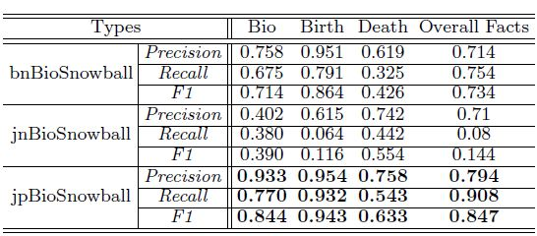
jpBioSnowball achieves better performance on both biography ranking and fact extraction
Pattern selection removes many uncommon patterns, while the training is much better when there is little noise

Slide 21
Experiments
Bootstrapping Framework
Complete bootstrapping framework on Web1M
Initial Seed: Randomly select 1000 bio-blocks from WikiSeed
Three interns manually label all the result blocks whether or not it is a bio-block
Randomly select 100 facts from all the extractions to evaluate precision and good extraction count

Slide 22
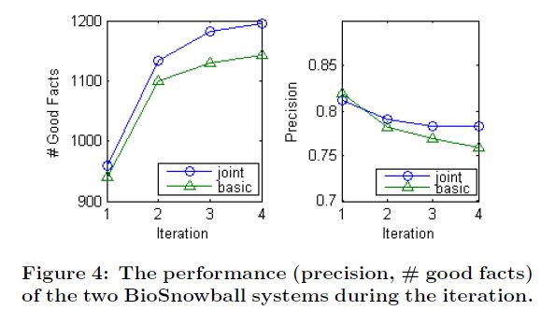
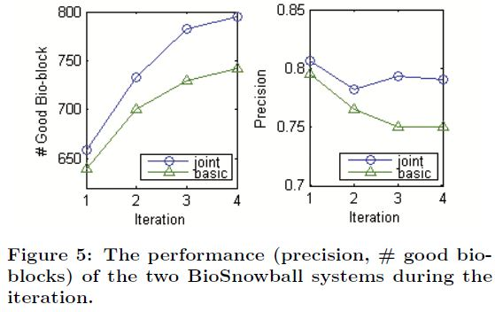

Slide 23
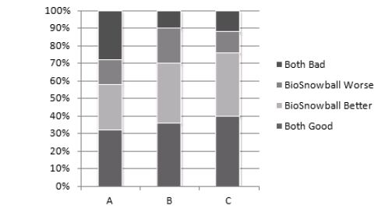
Experiments
Different Levels of Web Presence
User are asked to rank between summaries generated by BioSnowball and baseline
Three levels
Level A with 10-100 blocks indexed
Level B with 100-1000 blocks indexed
Level C with 1000-10000 blocks indexed
Each level randomly summarize 10 people and only the top 3 ranked blocks have been presented to users

Slide 25
Conclusions
We present an integrated bootstrapping framework to summarize the Web to generate Wikipedia-style pages for any person with a modest Web presence
By using the Bio-Fact duality, biography ranking and fact extraction are performed together with MLNs
By adopting a bootstrapping architecture, BioSnowball significantly reduces the number of human-tagged examples and iteratively mines facts and biography blocks
Empirical studies show that BioSnowball is effective

